Slide 1


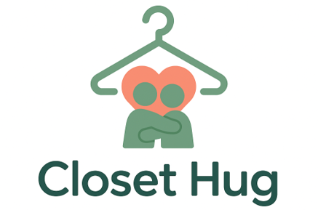

Closet Hug
Give Clothes a Second Life — and a Hug.
SwApps Corporations
swappscorporations.com

Slide 2

What is it? &
What does it do?
A sustainable clothing-swap app built for the circular economy. | Lets users swap clothes easily and earn rewards.
A community platform where fashion is shared, not wasted. | Builds trust through verification, reviews, and quality checks.
A point-based system that replaces buying with swapping. | Cuts fashion waste while saving users money.
01

Slide 3
Our Vision
“To empower people to exchange fashion, not waste it — building a world where every garment finds a new story.”
Our Mission
“To make fashion circular by refreshing wardrobes through a point-based swapping system supported by partnerships with eco-friendly brands.”
02

Slide 4
N.A.B.C.
Feature/Benefit/Value
  Need: Consumers want affordable, reliable ways to refresh their wardrobe without harming the environment. Rising fashion costs, limited variety, and distrust of used clothing create a clear unmet need.
  Approach: A trusted clothing-swap ecosystem using point-based exchanges, quality verification, and community hubs. Our app combines sustainability, gamification, and user-driven engagement to create a scalable circular fashion platform.
  Benefits: Users save money, gain variety, and enjoy trusted swaps supported by moderation and reviews. The platform reduces textile waste, promotes conscious fashion habits, and keeps users engaged through rewards.
  Competition: Closet Hug stands apart from resale apps by removing money barriers, ensuring quality control, and prioritizing sustainability. We compete with a community-driven, trust-centered, circular fashion model.
  Fair point-based swapping that makes fashion affordable.
  Quality checks and reviews that build trust in every exchange.
  Sustainable wardrobe refresh that reduces textile waste.
  Gamified rewards that keep users engaged and active.
  Community-driven platform that scales naturally across campuses and cities.
03

Slide 5
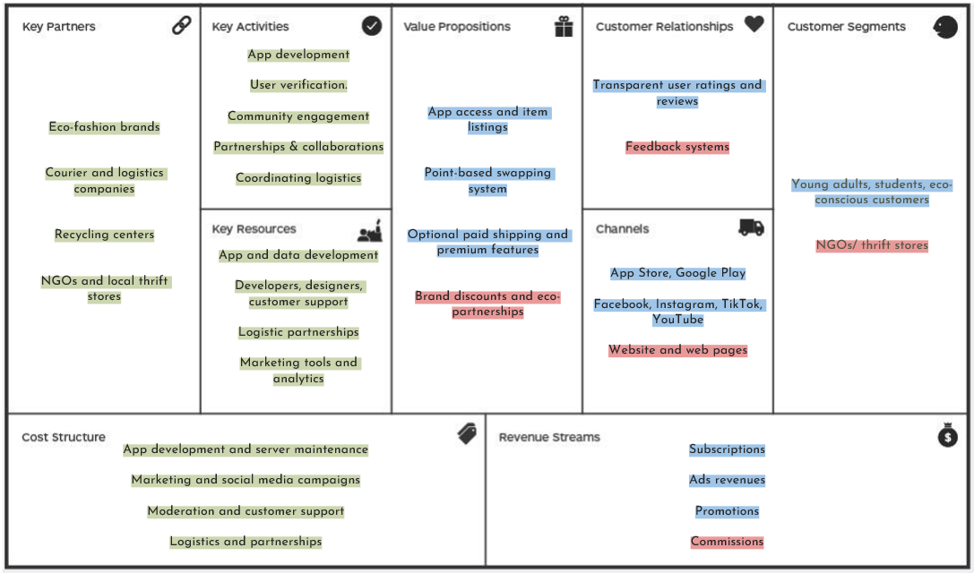

Business Model Canvas
04

Slide 6


Market Analysis
TAM
SAM
SOM
₩1.8 trillion (global circular fashion & resale market for Gen Z / young adults)
₩180 billion (South Korea sustainable fashion + secondhand market for students & young adults)
₩9–12 billion (achievable market share within 3 years)
Includes all consumers aged 15–34 engaging in thrift, secondhand, or sustainable fashion.
Rapid global growth in the reuse economy and clothing-swapping behavior.
Focuses on Korean consumers aged 18–29, especially university students and early professionals.
Represents those already engaged in thrifting, re-selling, and wardrobe-refresh habits.
Targets the first wave of adopters: campus communities, sustainability-focused users, and eco-friendly brand partners.
Represents ~5–7% penetration of the student and young adult segment in South Korea.
Customers
05

Slide 7



Marketing Strategies
Campus Activations & Student Ambassadors
Partner with universities to host swap pop-up events and launch “Campus Swap Hubs.”
Recruit student ambassadors to promote the app, drive sign-ups, and model swapped outfits.
Social Media & UGC (User-Generated Content)
Encourage users to post their swap experiences, before/after outfits, and “closet refresh” videos.
Collaborate with micro-influencers focused on thrift, sustainability, and affordable fashion.
Brand Partnerships & Eco-Collaborations
Partner with eco-friendly fashion brands to offer discounts, rewards, and limited-edition badges.
Use co-branded campaigns to increase visibility and position Closet Hug as a circular-fashion leader.
06

Slide 8

Sales Plan
User Acquisition & Activation
  10,000 registered users within the first 6 months
  40% of new users completing their first swap within 7 days
  Campus onboarding partnerships with at least 5 universities in Year 1
Swap Volume & Engagement
  Average of 3 swaps per active user per month
  60% monthly active user retention rate
  Daily swap activity growing steadily by 10% month-over-month
Revenue Growth & Conversion
  Achieve ₩80M revenue by end of Year 1 through premium plans, ads & brand collab.
  5% conversion rate of free users to premium features
  20 brand collaborations by end of Year 2
07

Slide 9
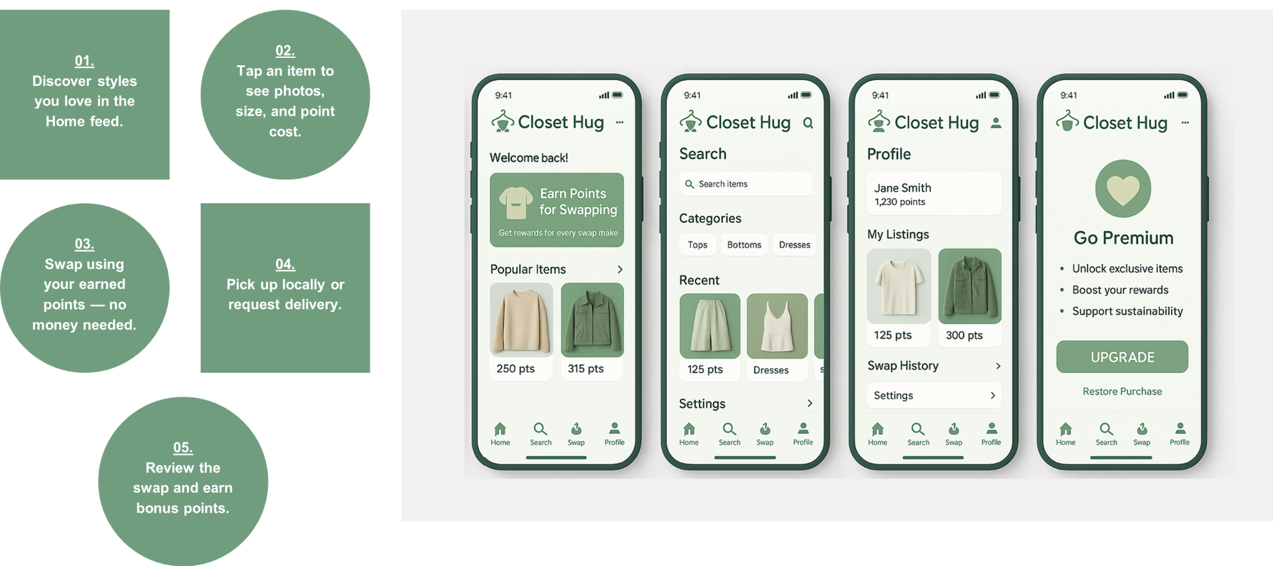
App Interface
“Unlock exclusive items and earn rewards faster with Premium.”
08

Slide 10
SWOT Strategy Matrix | Strengths - S Point-based model Trusted verification Strong eco appeal | Weaknesses - W Needs large user base Moderation workload Early revenue limits
Opportunities - O Sustainability trend University partners Gamified engagement | SO Strategies Use trust to partner Leverage eco appeal Gamify to scale | WO Strategies Use uni hubs for growth Partner to reduce workload Use brands for revenue
Threats - T Resale app competition Logistics challenges Trend/regulation shifts | ST Strategies Differentiate via model Promote sustainability Build trust advantage | WT Strategies Automate moderation Improve logistics hubs Diversify revenue streams
Competitive Analysis
09

Slide 11
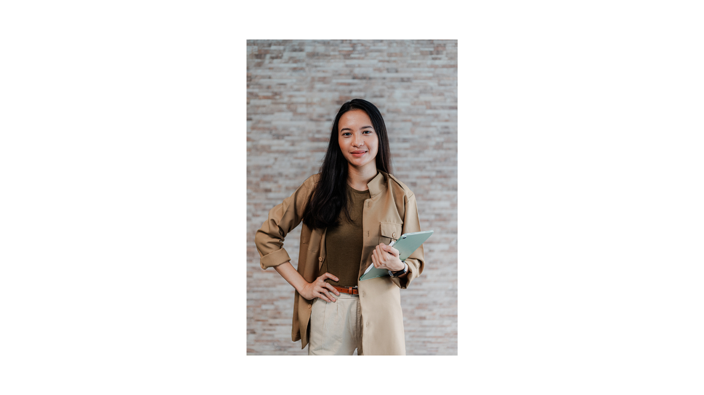



3C Framework
Company
Customer
Competitors
  Platform where users swap, to save money and the planet.
  Young adults, students, eco - conscious people, NGOs/ thrift stores.
  Danggeun (Karrot), Musinsa, Depop.
Competitive Analysis
10

Slide 12
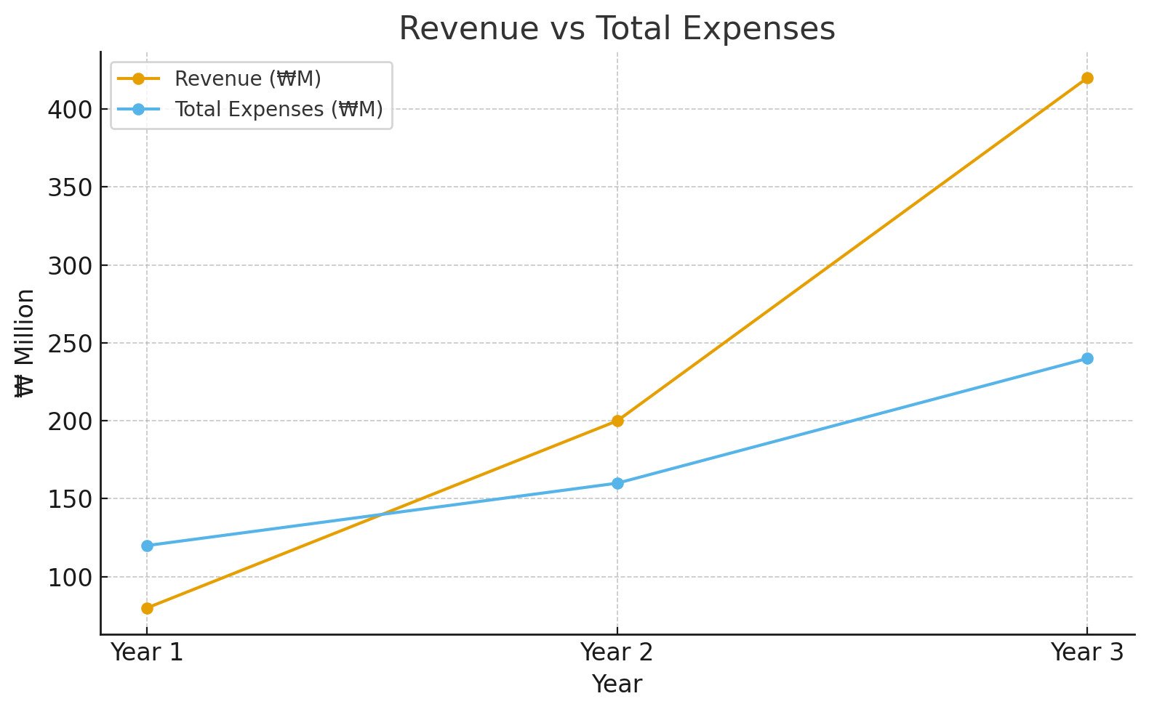
Financial Planning
  Revenue increases steadily as user base grows through campus onboarding and partnerships with eco-friendly brands.
  Optimize cost per acquisition through community-driven growth.
  Invest in app enhancement and moderation to maintain trust.
  Expand revenue through brand collaborations, premium features, and ad partnerships
11

Slide 13
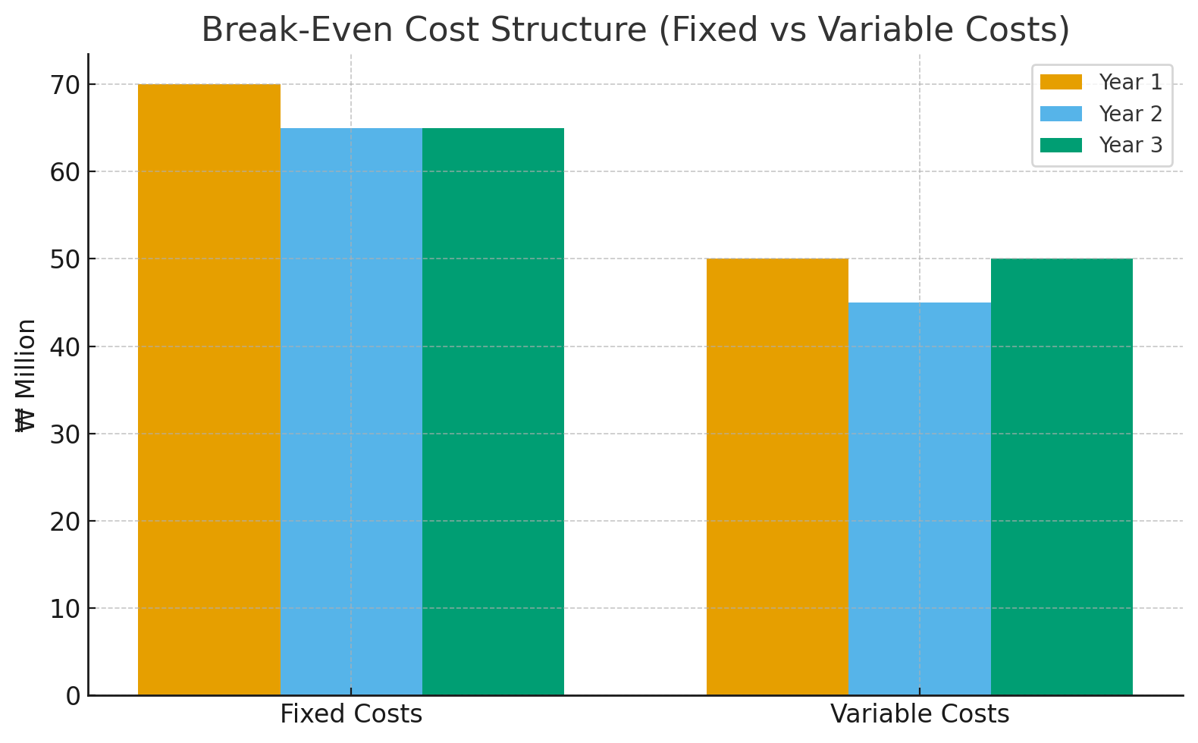
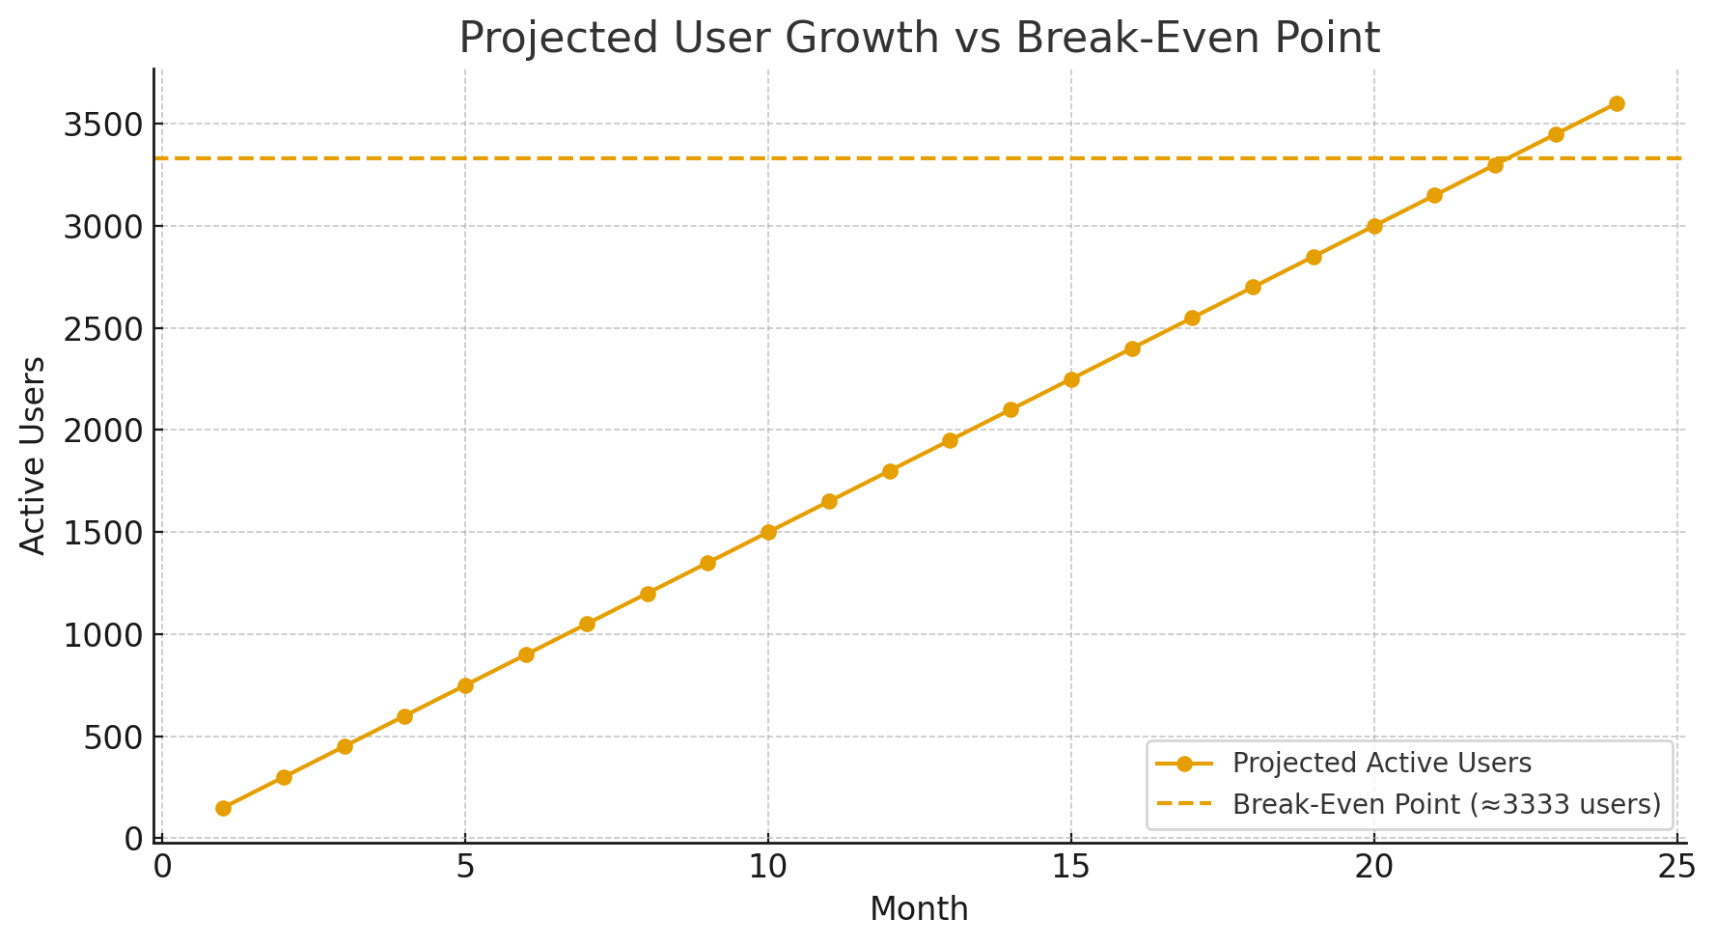
Break-Even Point
Fixed Costs: App development, servers, staff
Variable Costs: Marketing, user support, moderation
Revenue Streams: Brand partnerships, premium plans, ads
Increased swap volume raises advertising and partnership value.
User retention is high because swapping is cheaper than buying.
Fixed costs stay stable while user volume grows.
Break-even users = Fixed Costs ÷ (Revenue per user − Variable cost per user)
Financial Analysis
12

Slide 14
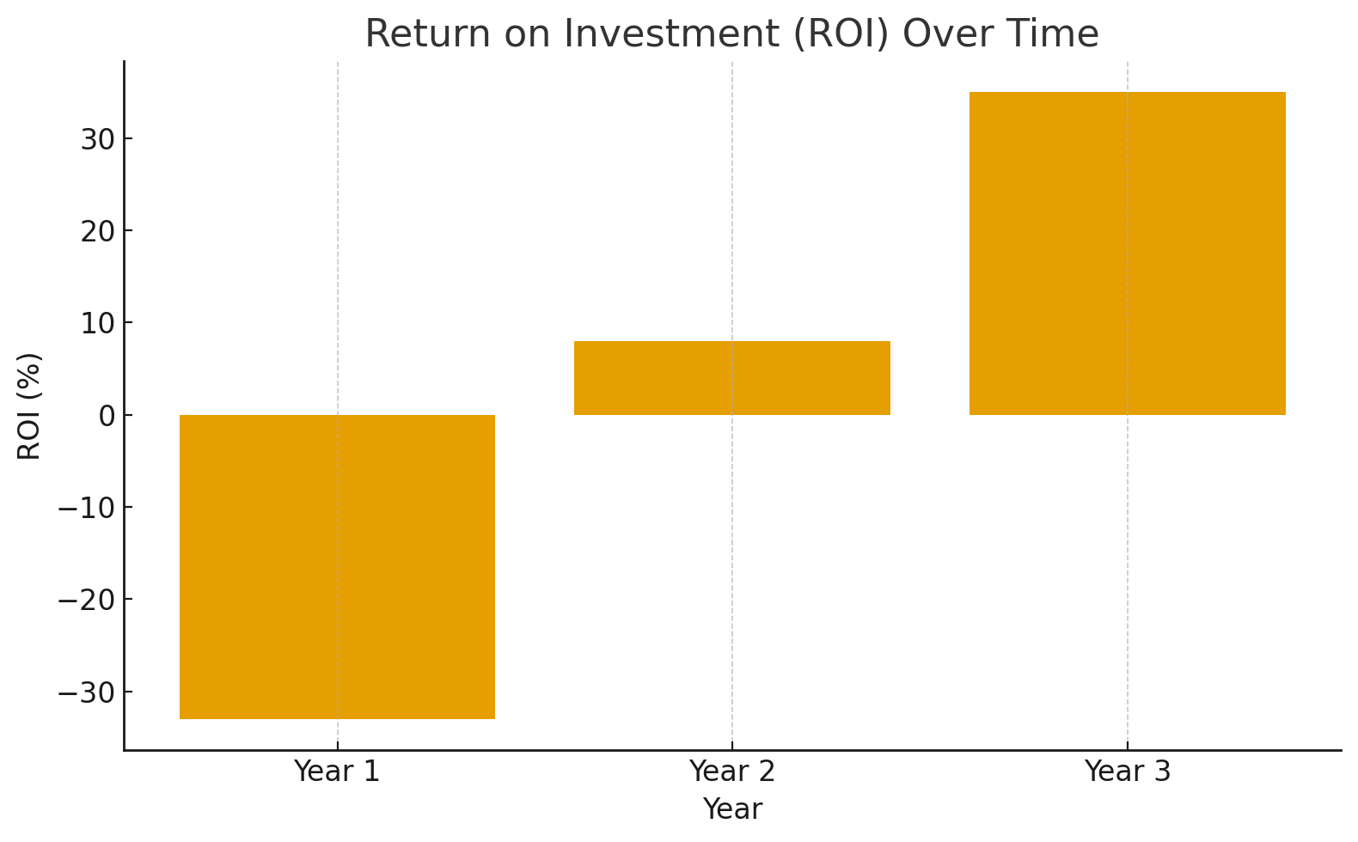
ROI
By Year 3, Closet Hug achieves a ~35% ROI, driven by strong user growth and low marginal cost per user.
ROI becomes positive after Year 2 once operational efficiency improves and customer acquisition becomes organic through community sharing.
Key Takeaway: A scalable, community-driven model allows Closet Hug to reach profitability early and maintain strong ROI as user numbers grow.
ROI = (Total Net Profit ÷ Total Investment) × 100
Assume:
Total investment in 3 years = ₩520M
Total revenue in 3 years = ₩700M
Net profit = ₩700M − ₩520M = ₩180M
Financial Analysis
13

Slide 15
General Management
Resources
Muhammad Hassan (COO)
Operations
Logistics
Daniela Gutierrez
(CEO)
Human Resource
Irfan Ali
(CMO)
Sales
Marketing
Budgeting
Finances
Rafsan Jany
(CFO)
Audits
Taxation
Our Leadership Team
14

Slide 16
Thank you!
Email
swapps@corporations.com
Social Media
@swappscorporations
Call us
012-3456-7890

